Slide 1
Movie Recommendation System

Slide 2
01
Data source

Slide 3
Data source
MovieLens 25M dataset
62,000 movies
Provided by GroupLens
25 million movie ratings and 1 million tag applications
Includes tag genome data with 15 million relevance scores across 1,129 tags
Features movie id, title, genres
162,000 users ratings
Ratings given on a scale of 1-5
Features user id, movie id, rating and timestamp

Slide 4
02
Why this data?

Slide 5
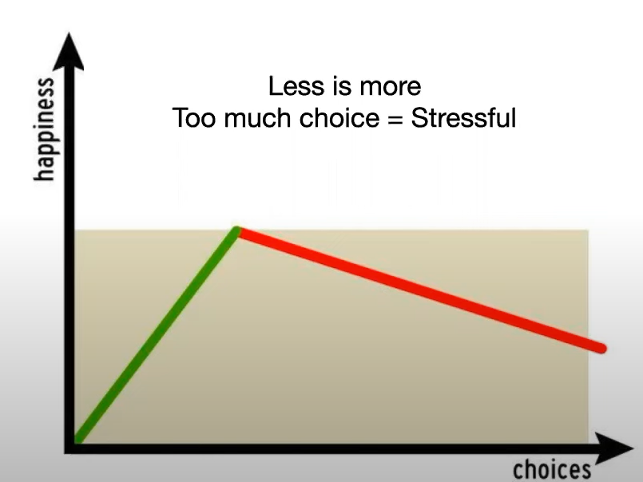
Why this data?
Paradox of choice
45 hours per year
Explained by Barry Schwartz
Average American consumer spends cumulatively 7.4 min per day amounting to 45 hours per year choosing what to watch next
(source: Nielsen Total Audience Report Q1, June 2019)

Slide 6
03
Methodology

Slide 7
Methodology
Data preprocessing
Data integration
Cleanse and preprocess the datasets to handle missing values, outliers, and inconsistencies in movie titles or other features
Merge the movie details and user ratings datasets based on common identifiers (e.g., movie ID) to create a comprehensive dataset for analysis
Model development
Model evaluation
Implement various recommendation algorithms such as collaborative filtering (user-based, item-based), content-based filtering, and hybrid approaches
Assess the performance of the developed recommendation system using evaluation metrics such as precision, recall, and mean average precision (MAP)

Slide 8
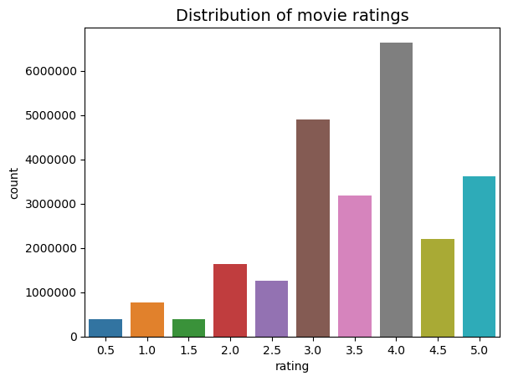
Exploratory data analysis

Slide 9
Exploratory data analysis
Most frequently rated movies
Forrest Gump
Shawshank Redemption
Pulp Fiction
Highest rated movie
Lamerica (1994)
Lowest rated movie
Gypsy (1962)

Slide 10
04
Models

Slide 11
Content-based filtering
Applied Inverse Document Frequency (IDF) for Title Vectorization
Utilized IDF to vectorize unique words within movie titles
Gave more weight to the less common words in the titles
Cosine Similarity for Comparison
Employed cosine similarity to assess the similarity between vectorized movie titles.
Higher similarity scores indicate movies with titles having angles closer to 0, suggesting parallelism in themes
Interpreting Similarity Scores
Higher scores indicate greater similarity, suggesting movies with closely related themes
Lower scores indicate dissimilarity, with angles closer to 90 degrees, implying distinct themes
Recommendation Algorithm
Tailored recommendations based on higher similarity scores, and suggested 5 movies

Slide 12
Collaborative filtering
Identifying Similar Users
Locate users who watched the same movie and rated it above 4 stars.
Establish a basis for finding users with similar tastes.
Recommendations from Similar Users
Gather movie recommendations from users who share similar preferences and prioritize highly rated movies by these users
Differentiating Liked Movies
Distinguish movies liked by users similar to us from those universally liked
Aim to recommend movies closely aligned with our preferences
Recommendation Algorithm
Combine percentage of recommendations from similar users and all users and calculate score
Recommend top 5 movies based on the calculated recommendation scores

Slide 13
Thanks

